Slide 1

Research Presentation
Sanjay Jagadeesh

Slide 2

Original Research Question
In the future, how will the implementation of AVs change in the United States, and will it differ between different regions of the country?

Slide 3
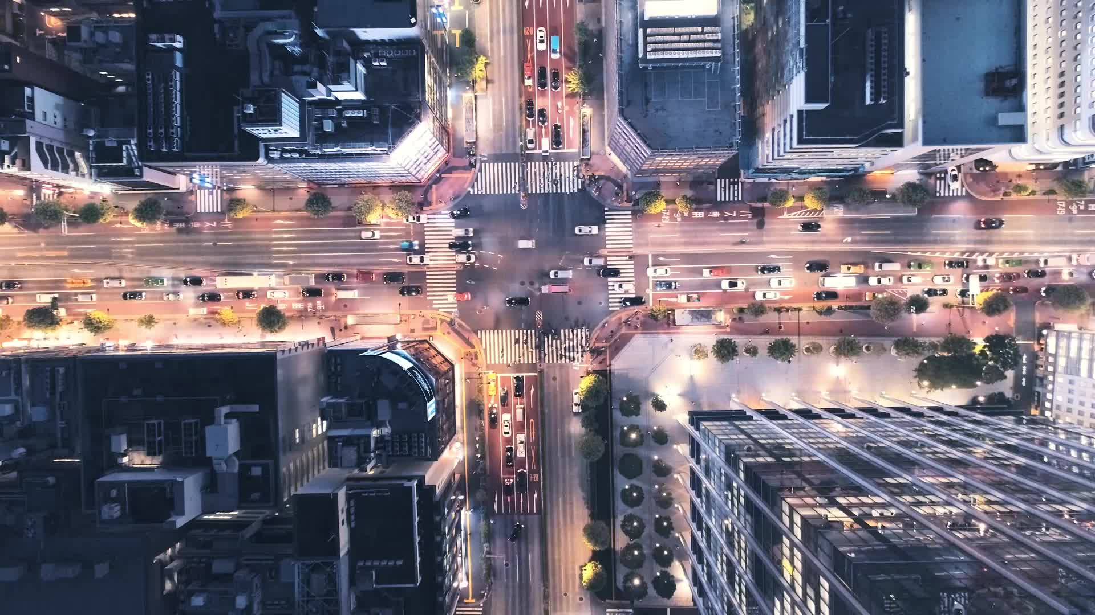
Thesis
In the future, AVs will see limited growth across the nation, with most of the growth concentrated in urban areas.

Slide 4
Key Terms
Autonomous Vehicles
AVs
Self-Driving Cars
Driverless cars
Growth
Increase
Usage
Implementation
United States
U.S.
Regions
Areas
Cities
Differences
Variance

Slide 5
Key Points
Infrastructure is critical
Large urban areas are more likely to be prepared for AVs
AV usage has numerous benefits as well as drawbacks
Less parking spaces/curb space
Smaller lanes
Less pollution
Elderly transportation
Increased congestion
Urban sprawl
City characteristics will play a big role in AV preparation
Predicted surge in AV usage

Slide 6
Conflicting Viewpoints
For:
Predicted surge in AV implementation
Many cities experimenting with AV usage
Removes risk of human error
Positives:
Less pollution
Less parking spaces/curb space needed
Decrease in congestion
Lower costs after implementation
New tech. industry jobs
Benefits for elderly/other vulnerable groups
Against:
Few local governments have begun planning for AVs
Negatives:
More vehicle miles
Increased urban sprawl
Decrease in some industries
Billions in repair/infrastructure startup costs
Fatalities related to AVs
Pavement deterioration
Possible legal regulations

Slide 7

Further Research
For further research, I would like to go more into the effects AVs will have on urban areas and if/how AVs will disperse/become more relevant in rural areas as time goes by.

Slide 8
Outline
Introduction
Background on AVs
What are AVs?
Current situation of AVs
Question: In the future, how will the implementation of AVs change in the United States, and will it differ between different regions of the country?
Thesis: In the future, AVs will see limited growth across the nation, with most of the growth concentrated in urban areas.
Future Expansion of AVs
Benefits & Drawbacks
Less pollution, parking spaces, curb space, new jobs created in tech.
More urban sprawl, jobs lost in some industries, infrastructure cost.
Urban vs. Rural
Differences in Preparation
Transit
Infrastructure
Impact on Cities
Changes in:
Possible diffusion to rural areas (after some time)
Possible benefits to rural areas
Ways AVs can be implemented outside cities.
Rebuttal
Why AV growth will occur sooner/later.
Conclusion
Landscape
Transportation
Technology
Jobs
Policy

